Slide 1
GenAI HW10
TA: Nai-Xuan Ye, Hsi-Che Lin, Hsiang Hsieh
ntu-gen-ai-2024-spring-ta@googlegroups.com
Deadline: 2024/06/13 23:59:59 (UTC+8)
Notes:
Name

Slide 2
Outline
Link
Overview
Task Introduction
Fine-tune Stable Diffusion
Generate Images
Evaluation Metrics
Grading Policy
Result Submission
Training Code

Slide 3
Disclaimer
The human faces generated using the stable diffusion model for this homework are solely for educational and research purposes. They are generated by artificial intelligence algorithms and may not accurately represent real individuals.
It is important to acknowledge that the use of AI-generated images may raise ethical considerations, and it is the responsibility of users to use them ethically and responsibly.
The creators of the stable diffusion model and the developers of the tools utilized in this homework bear no liability for the use or consequences of these generated images.

Slide 4
Overview

Slide 5
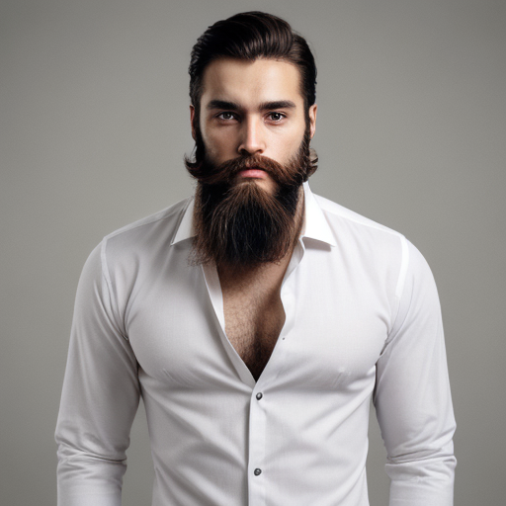
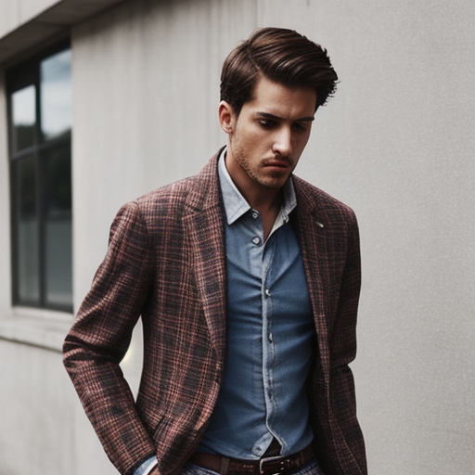
Text-to-Image Model
Text-to-image model can generate images that matches input description
Text-to-Image Model
a man with a beard and a white shirt.
a man wears a tank top and blazer.

Slide 6
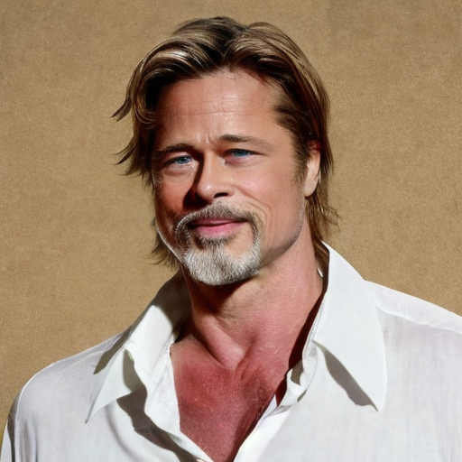
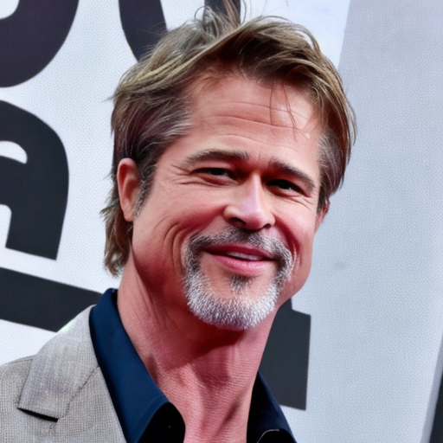
Personalization
Publicly available text-to-image models may not meet everyone’s need. E.g., a model generating images of a specific person consistently
Text-to-Image Model
a man with a beard and a white shirt.
a man wears a tank top and blazer.

Slide 7
Achieve Personalization Using LoRA
LoRA is a technique to make small changes to a trained model (ref)
Add LoRA modules to model
(model gets additional capacity)
Then fine-tune it.
Model that generate good images
& do personalization
Model that generate good images
Text-to-Image Model
Text-to-Image Model
LoRA
Text-to-Image Model
fine-tune
LoRA
Data
a man with a beard and a white shirt.
a man with a beard and a white shirt.
Notes:
Ref

Slide 8
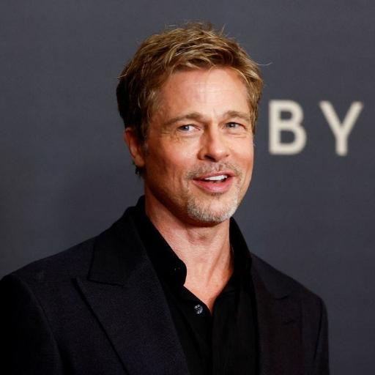
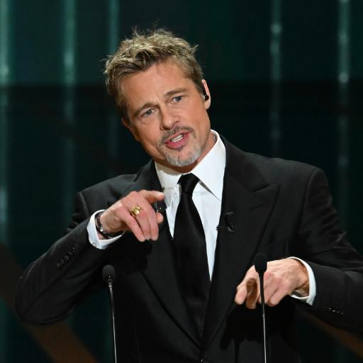
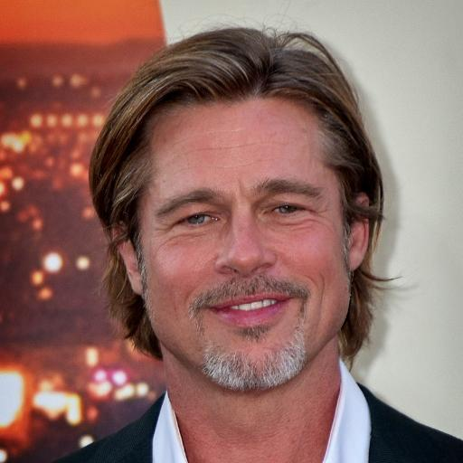
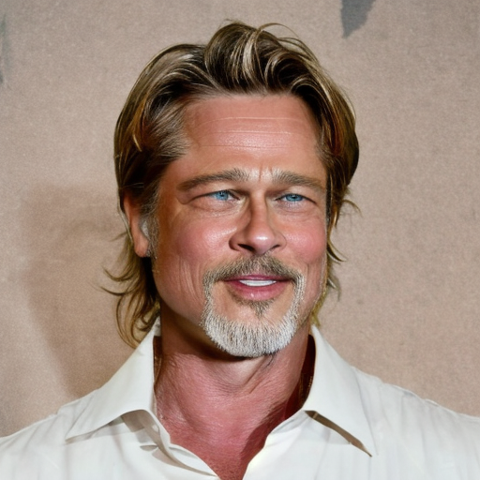
Goal of This Homework
You will learn how to make Stable Diffusion generate consistent facial results by fine-tuning it with identical faces.
Original Model
a man with a beard and a white shirt.
fine-tune with LoRA
(images & paired text)
Personalized Model
a man with a beard and a white shirt.
LoRA

Slide 9
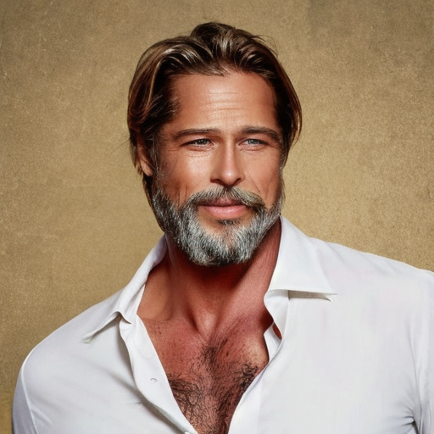
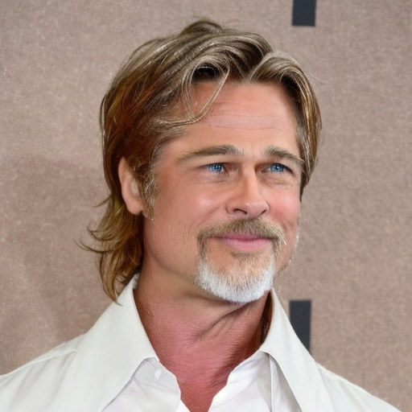
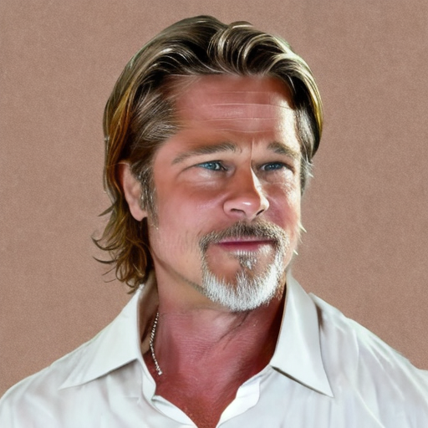
Goal of This Homework
Given enough training time, Stable Diffusion will start to produce images of the same individual.
Training Step
a man with a beard and a white shirt.

Slide 10
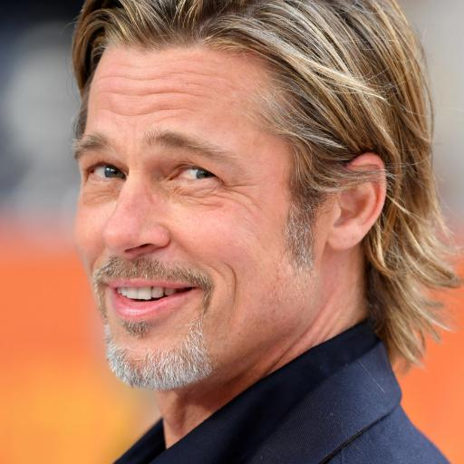
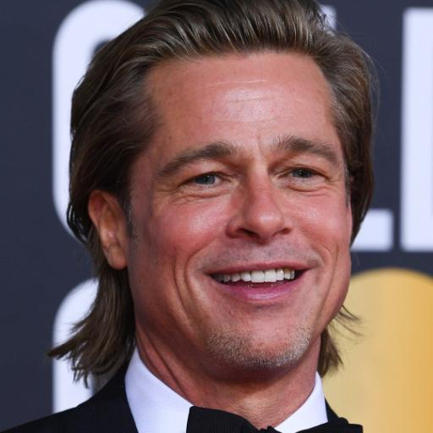
Evaluation
We will give you some text prompts
You need to submit images generated from the prompts
The score will evaluated based on
Are the images similar to training data
Are the images and text matched
Do the images contain human faces
Image 1
Image 2
Image 3
Personalized Model
LoRA
Text prompt 1
Text prompt 2
Text prompt 3

Slide 11
Task Introduction

Slide 12
Task Introduction
1. Fine-tune Stable Diffusion
Using LoRA technique
2. Generate Images
Using provided validation prompts
3. Evaluate Images
Evaluated by GhostFaceNet and CLIP

Slide 13
TODOs
Try out different hyperparameters to fine-tune your own model. (Using default setting will result in at most 8 points)
The training time will take about 1 hours. Each account is only able to run the code twice a day. You might have to try different hyperparameters multiple time. Please start to work on this assignment as early as possible. We won’t extend the deadline given the long training time.
Please ensure your Google Drive has a minimum of 4GB of available space to accommodate 2 stable diffusion checkpoints.
We provide 25 different prompts to describe clothing. You have to ensure that your model can generate images with same faces as training dataset based on these prompts.

Slide 14
Step 1. Fine-tune Stable Diffusion

Slide 15
Fine-tune a Stable Diffusion LoRA Model
Choose a model based on Stable Diffusion from Hugging Face and use LoRA technique to fine-tune Stable Diffusion.
Before fine-tuning, try to understand and adjust hyperparameters of LoRA so that your model can have better performance in the end.
Fine-tuning will take about 30 minutes

Slide 16
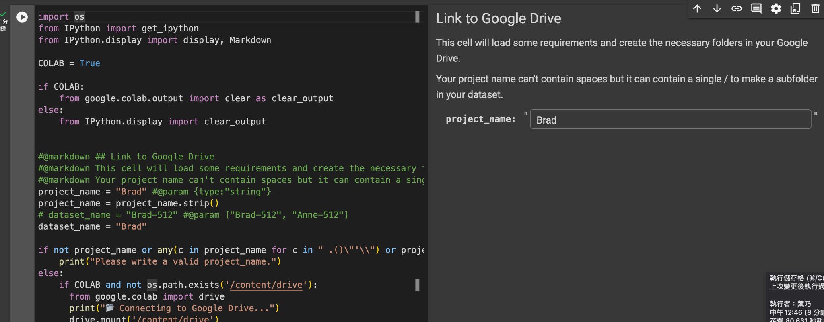
Link to Google Drive
Run the cell
(Optional) Change folder name or Dataset folder in Google Drive

Slide 17
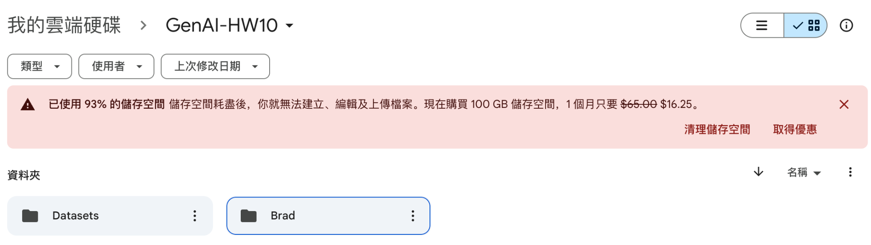
Link to Google Drive
We will build GenAI-HW10 folders in your Google drive
Make sure you have at least 4GB space on the Google drive

Slide 18
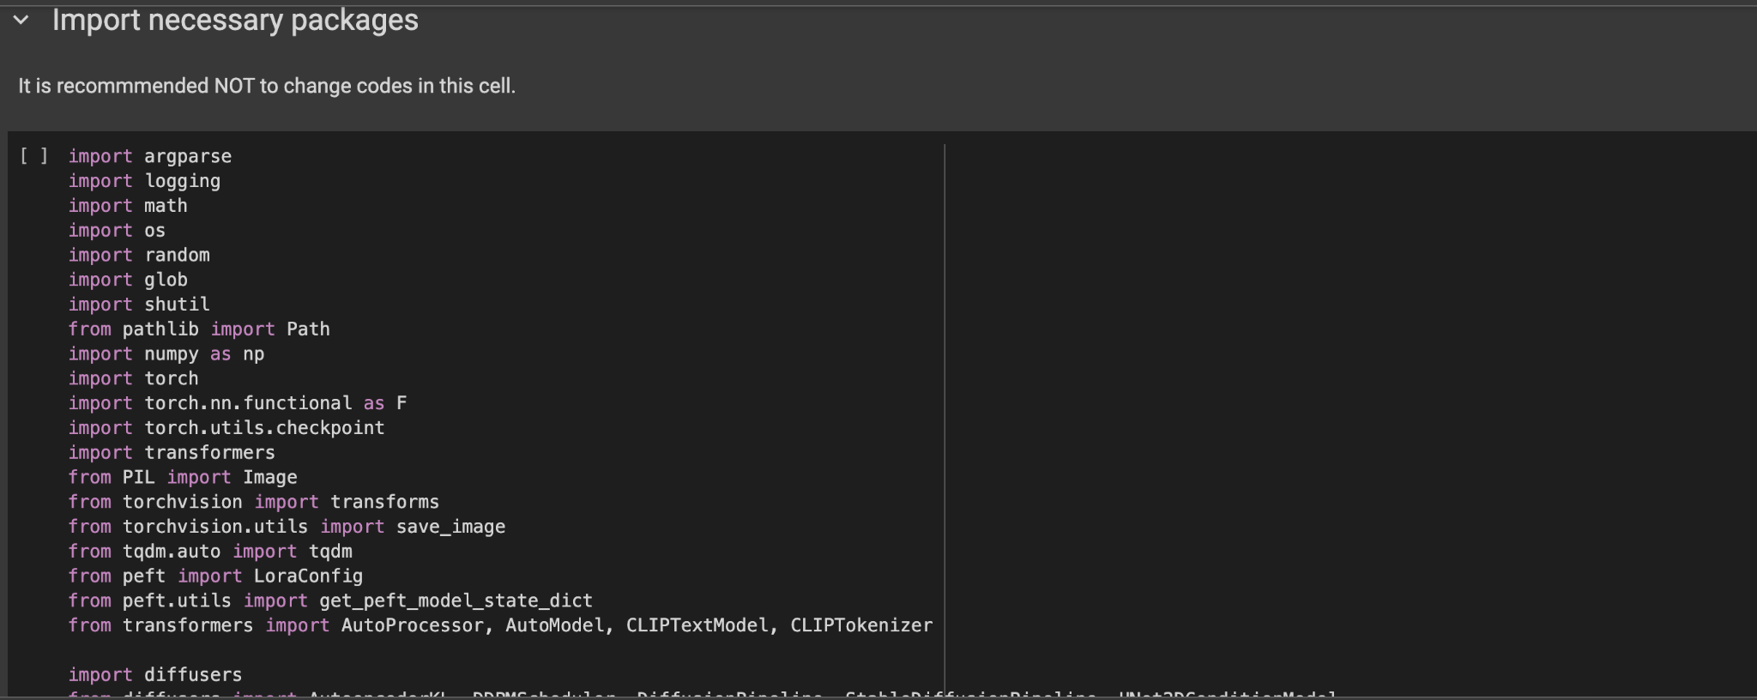
2. Import required packages for fine-tuning

Slide 19
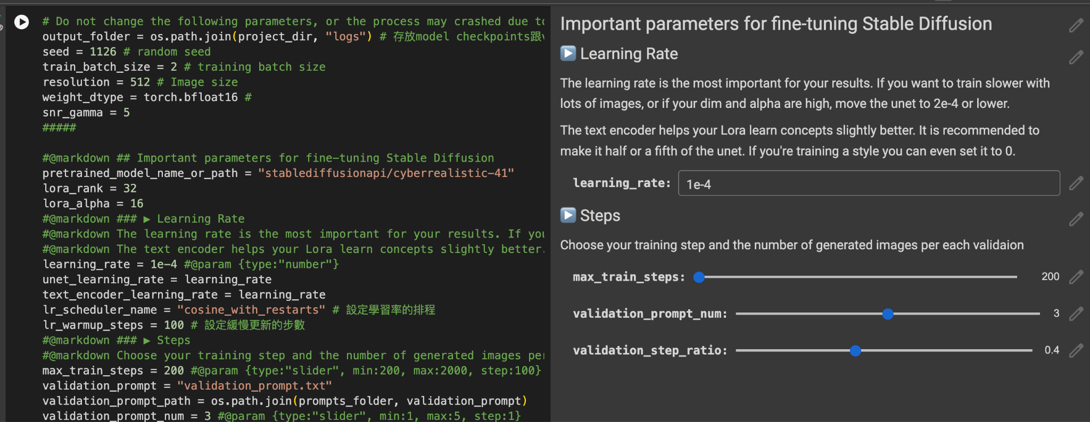
3. Adjust the hyperparameters

Slide 20
3. Adjust the hyperparameters
learning_rate (recommended): learning rate of model
Increase this make model focus more on our training data than text prompt (Face distance↓(good) and CLIP score↓(bad))
max_train_steps: total training step
validation_promt_num: the number of validation images
validation_step_ratio: ratio between validation step and max_train_steps

Slide 21
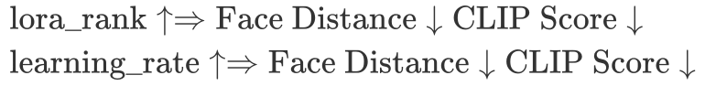
3. Adjust the hyperparameters
lora_rank: the dimension of LoRA model
lora_alpha (recommended): weight of LoRA model
learning_rate (recommended): learning rate of model
max_train_steps: total training step
validation_promt_num: the number of validation images
validation_step_ratio: the ratio between validation step and max_train_steps

Slide 22
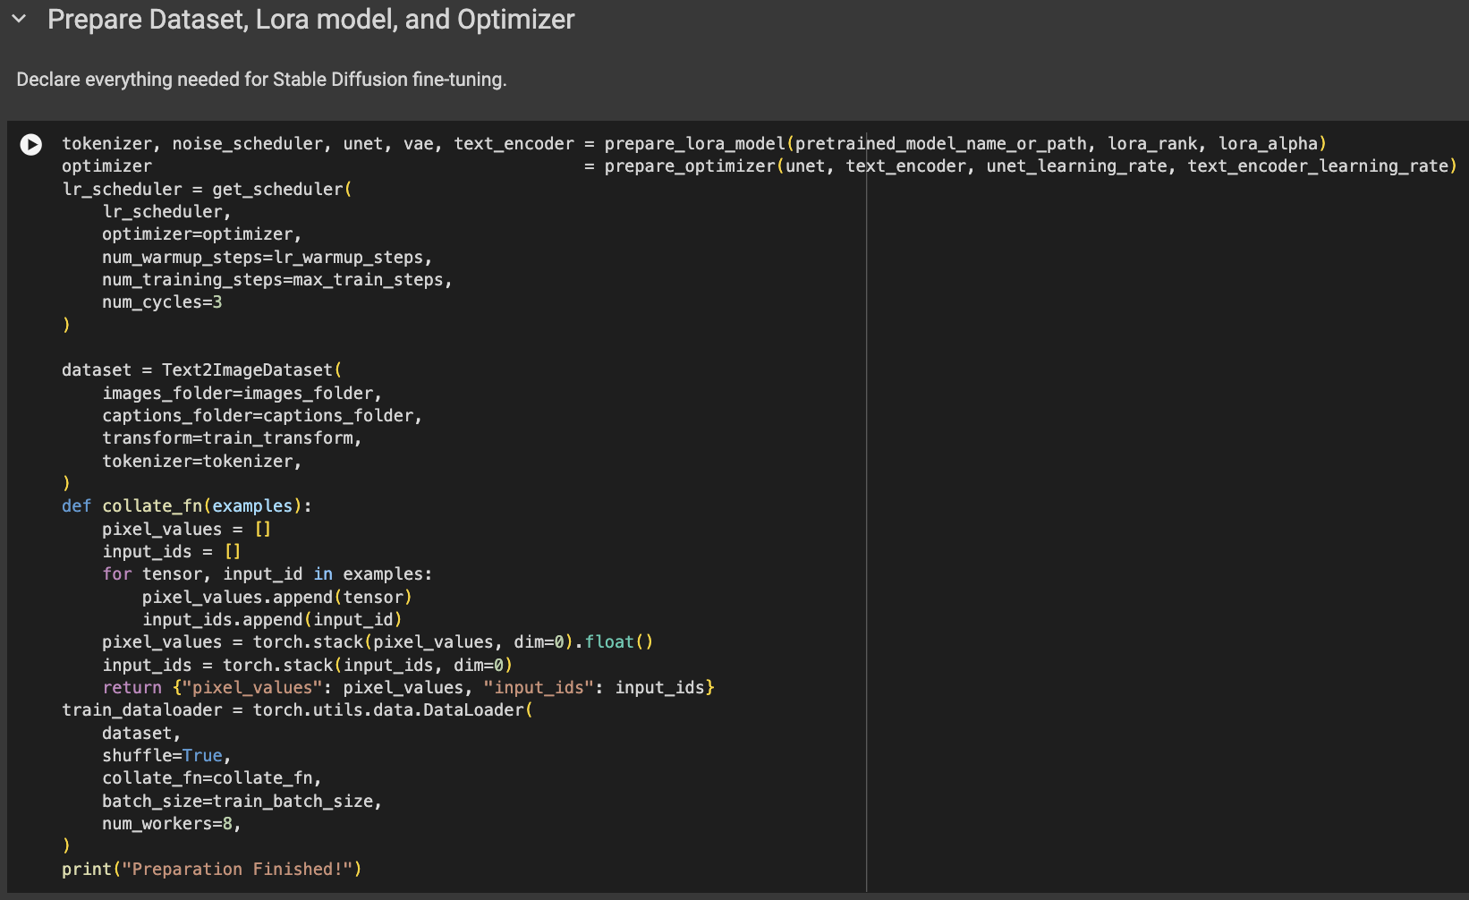
4. Prepare Dataset, LoRA model, and Optimizer

Slide 23
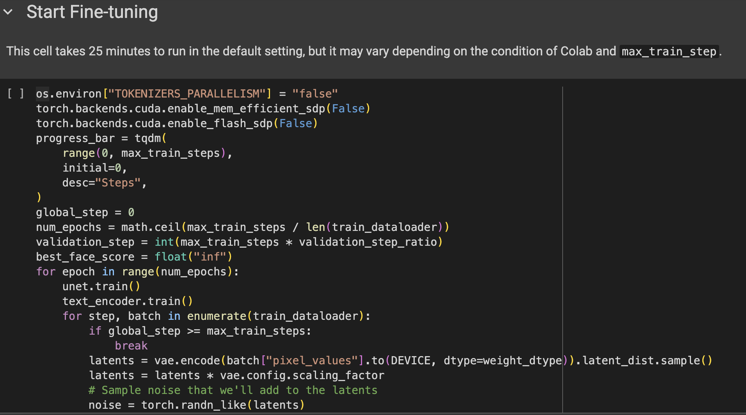
5. Start Fine-tuning

Slide 24
Step 3. Generate Images

Slide 25
Generate Images
Use TA’s validation prompts and your fine-tuned model to generate images.
Testing will take at least 15 minutes
Image 1
Image 2
Image 3
Personalized Model
LoRA
Text prompt 1
Text prompt 2
Text prompt 3

Slide 26
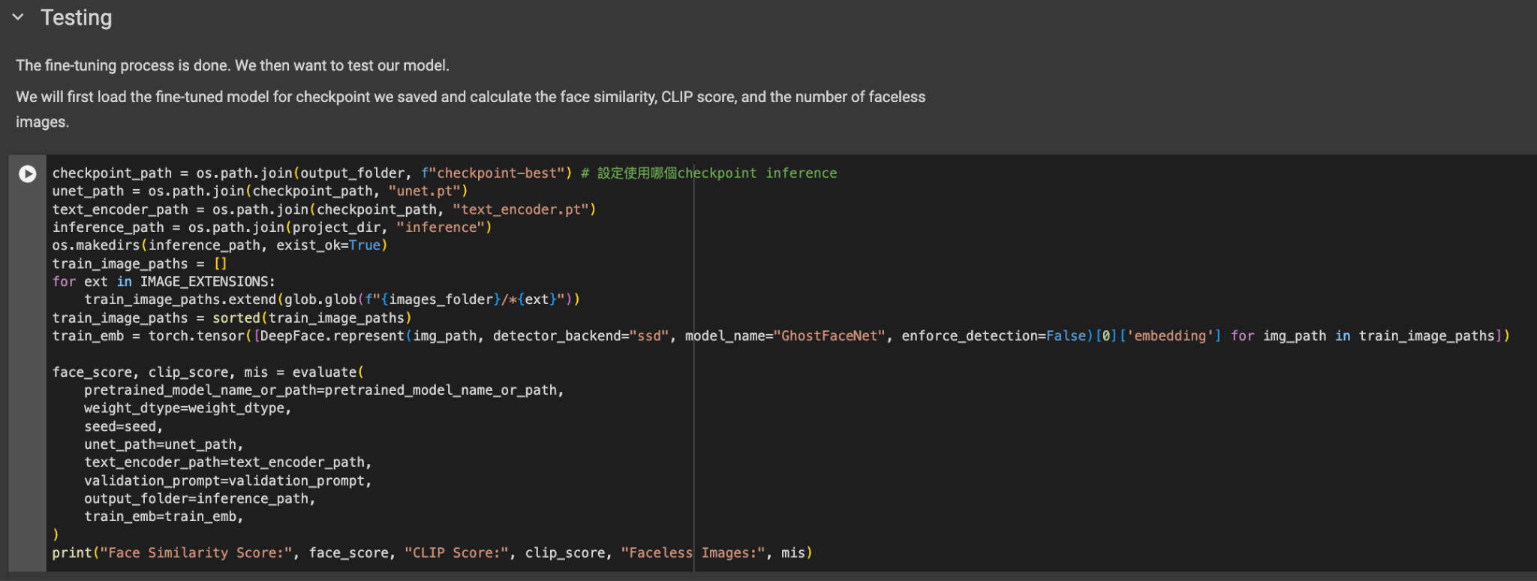
Generate Images

Slide 27
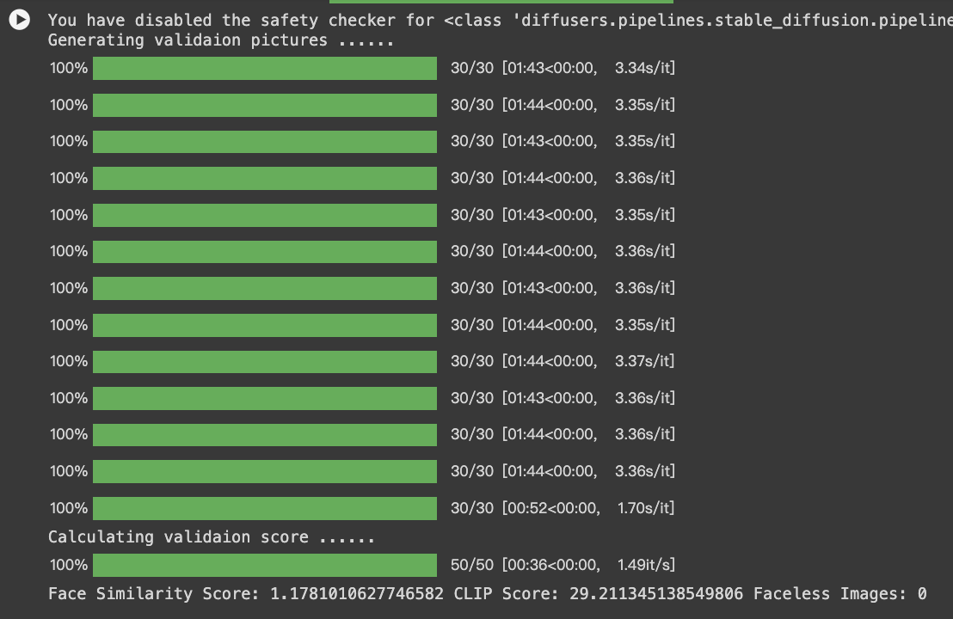
Generate Images

Slide 28
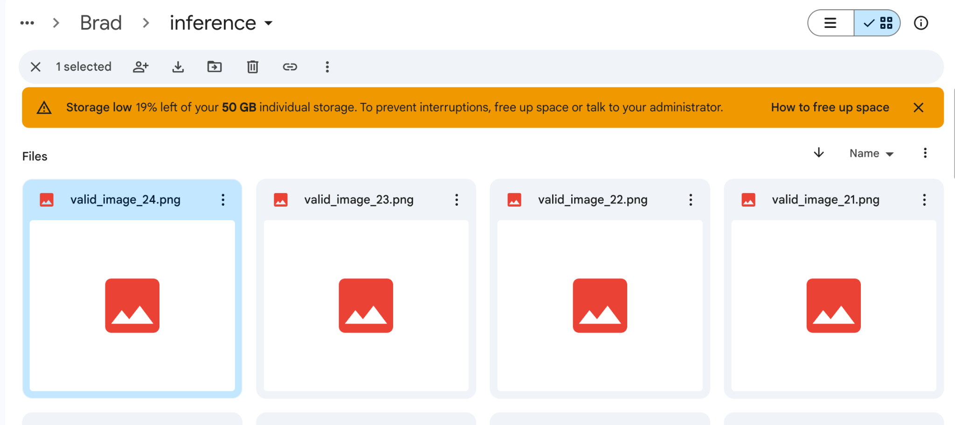
Generate Images
The generated images will be saved in Google Cloud <project_name>/inference/
Please zip images in this folder and submit it to NTU Cool.

Slide 29
Step 4. Evaluate Images

Slide 30
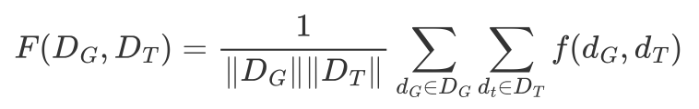
Evaluation Metrics - Face Distance Score
For each generated face, we find its average distance to training data and average this distance across all generated faces.
Distances between faces determined by a neural network, GhostFaceNet
Since we want a model that generates a specific person, less average distance is better.
Paper reference: GhostFaceNets

Slide 31

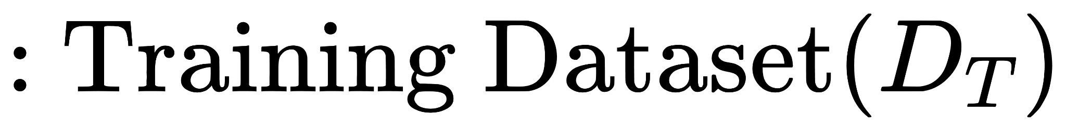
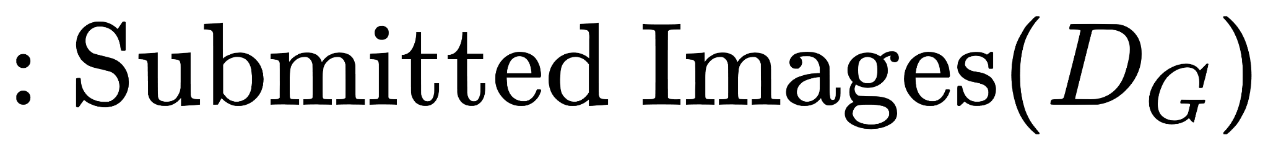
Evaluation Metrics - Face Distance Score
d1, d2, d3, d4 are computed by GhostFaceNet
Face distance score is the average of d1, d2, d3, d4
The more similar the smaller d is (smaller is better)
d3
d4
d1
d2

Slide 32
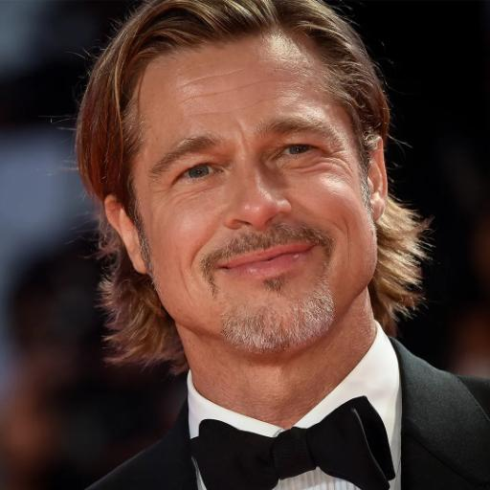
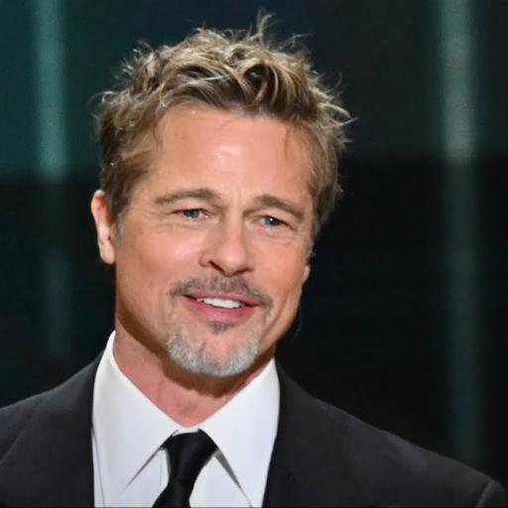
Evaluation Metrics - Face Distance Score
However, merely calculating the face similarity is not ideal since it can easily be hacked by submitting 25 pictures of same person.
Training Dataset
Submitted Validation Images

Slide 33
Evaluation Metrics - Face Distance Score
Or just submit same picture 25 times.
Training Dataset
Submitted Validation Images

Slide 34
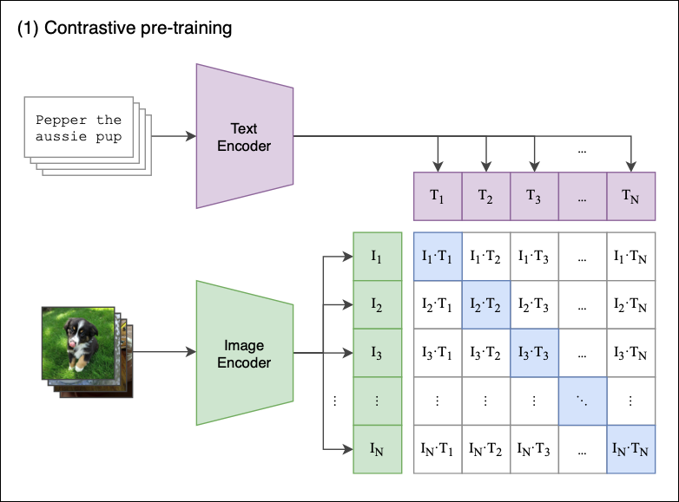
Evaluation Metrics - CLIP Score
To avoid such cases, we will calculate CLIP score to ensure that prompts are truly related to image.
CLIP score can measure the similarity between text and image, where higher scores indicates greater relevance between the two modalities.
By doing so, unless you can find images of the same person with 25 different clothes mentioned in validation prompts, or you’ll have to fine-tune your own text-to-image model.
Paper reference: CLIP

Slide 35
Evaluation Metrics - CLIP Score
s1, s2 are computed by CLIP
CLIP is the average of s1, s2
The more similar the higher s is (higher is better)
a man with a beard and a white shirt.
s1
a man wears a tank top and blazer.
s2

Slide 36
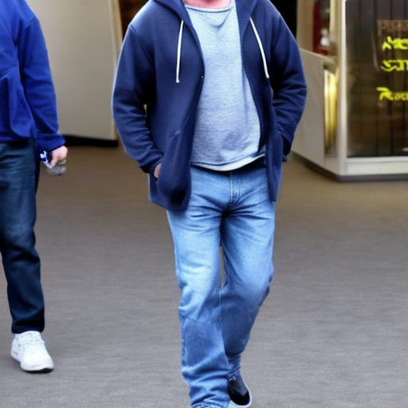
Evaluation Metrics - The number of Faceless Images
Since it is inevitable that sometimes Stable Diffusion generates images that are related to input text but faceless.
To avoid rerunning generation process, we tolerate at most 5 submitted validation images without faces.
a man dressed casually in a hoodie and jeans

Slide 37
Grading Policy
You have to use validation prompt with same gender as your training dataset to generate images.
Scoring:
Face distance:
≤ 1.2 → 10 pts
≤ 1.22 → 8 pts
≤ 1.25 → 6 pts
≤ 1.28 → 4 pts
≤ 1.3 → 2 pts
CLIP Score > 22, or you’ll get 0 pts
The number of faceless images ≤ 5, or you’ll get 0 pts
Default setting in sample code can obtain at least 8 pts

Slide 38
Submission & Deadline
Submit your homework to NTU Cool
Please submit <student-id>.zip (start with capital) to NTU Cool. The directory after unzipping should be like:
B09902008
valid_image_0.png
valid_image_1.png
…
valid_image_24.png
2024/06/13 23:59:59 (UTC+8)
No late submission is allowed

Slide 39
Grading Release Date
The grading of the homework will be released by 2024/06/21 23:59:59 (UTC+8)

Slide 40
需要提早送出成績的同學
本課程學期成績預計於6/30送出
若有同學因為要畢業需要提早拿到學期成績，請在 6/12 23:59:59 (UTC+8) 之前寄信跟助教說明需要提早送出成績的原因，我們會在 6/17 送出你的成績。寄信說明如下：
助教信箱: ntu-gen-ai-2024-spring-ta@googlegroups.com
信件標題: [GenAI 2024 Spring 提早送成績]
An email with the wrong title will be moved to trash automatically
寄給助教的信件應該包含以下資訊：
姓名
學號
你需要提早送出成績的理由
需要提早送成績的同學，我們會在 6/16 公佈你的HW10成績。若同學覺得HW10成績有問題，需要在 6/17 前反應，成績送出後不會再受理修改成績的要求

Slide 41
If You Have Any Questions
NTU Cool HW10 作業討論區
如果同學的問題不涉及作業答案或隱私，請一律使用NTU Cool 討論區
助教們會優先回答NTU Cool討論區上的問題
Email: ntu-gen-ai-2024-spring-ta@googlegroups.com
Title should start with [GenAI 2024 Spring HW10]
Email with the wrong title will be moved to trash automatically
TA Hours
Time: 5/31 (Fri.) 16:30 ~ 17:20, 6/7 (Fri.) 14:20~16:10
Location: 綜合大講堂

